Slide 1
For he's a jolly good fellow
Which nobody can deny

Slide 2
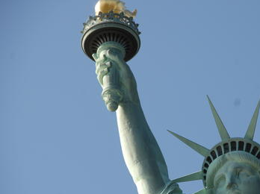
Beyond Carrying Coal To Newcastle: Dual Citizen Circuits
Dedicated to Alex Yakovlev's 60th birthday
Narrated by Marly Roncken and Ivan Sutherland
Portland State University — 20 July 2016
This Asynchronous World - Dual Citizen Circuits

Slide 3
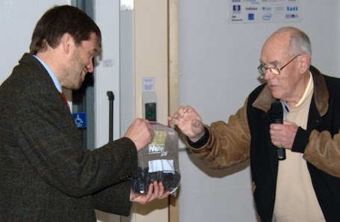
ASYNC 2008: Carrying Coal To Newcastle
Notes:
"Carrying Coal to Newcastle" is an idiom of British origin describing a pointless action.
It refers to the fact that, historically, the economy of Newcastle upon Tyne depended
heavily on the distribution and sale of coal. By the time of the first known recording
of the phrase in 1538, Newcastle exported 15,000 tons of coal per year. [Wikipedia]

Slide 4
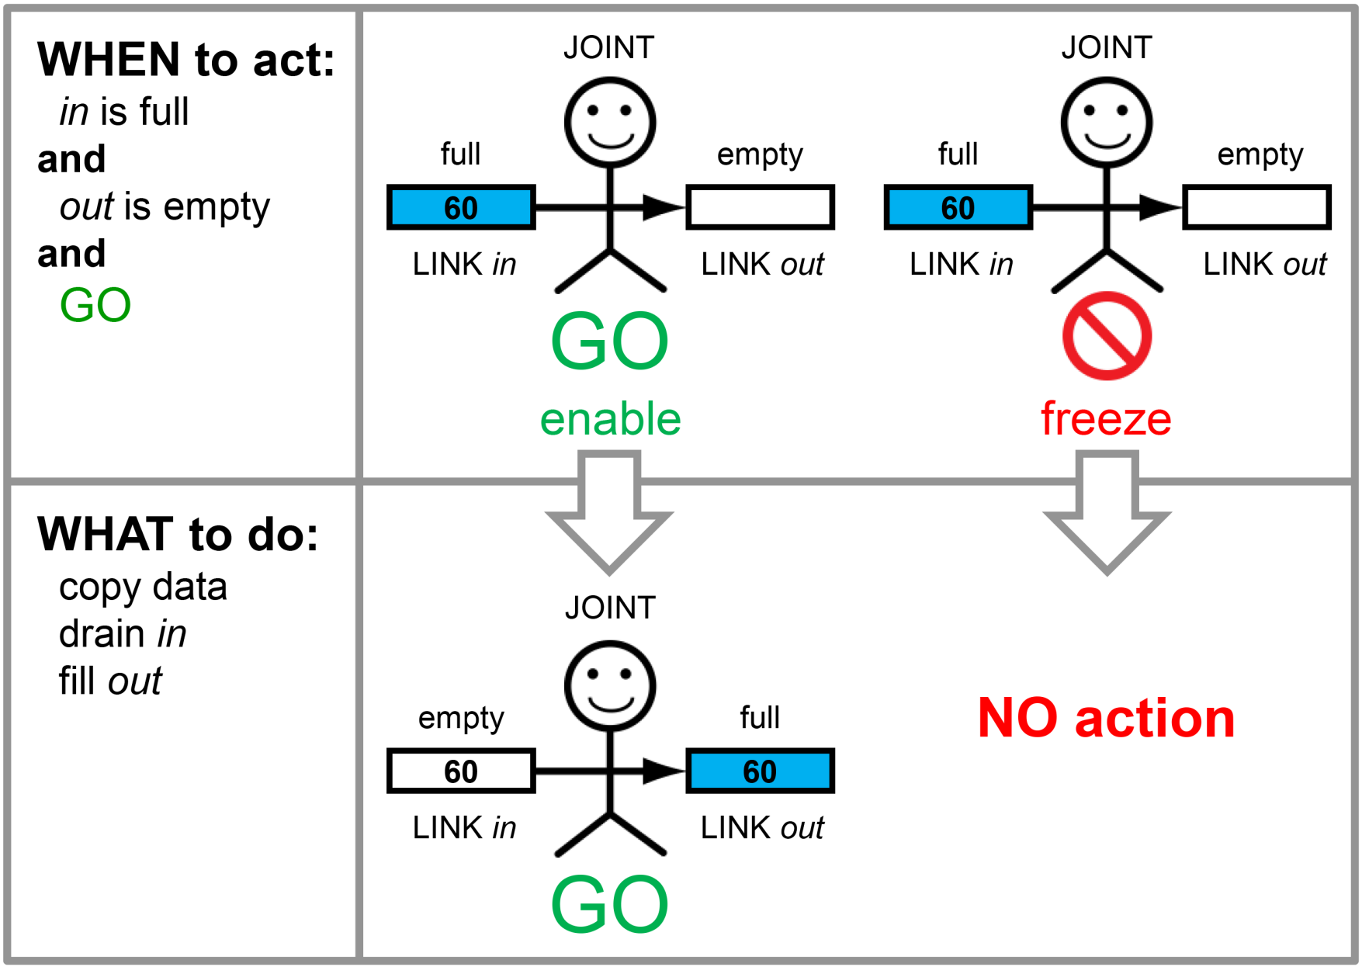
Today: Dual Citizen Circuits with self-timed or clocked action
as before
self-timed or clocked

Slide 5
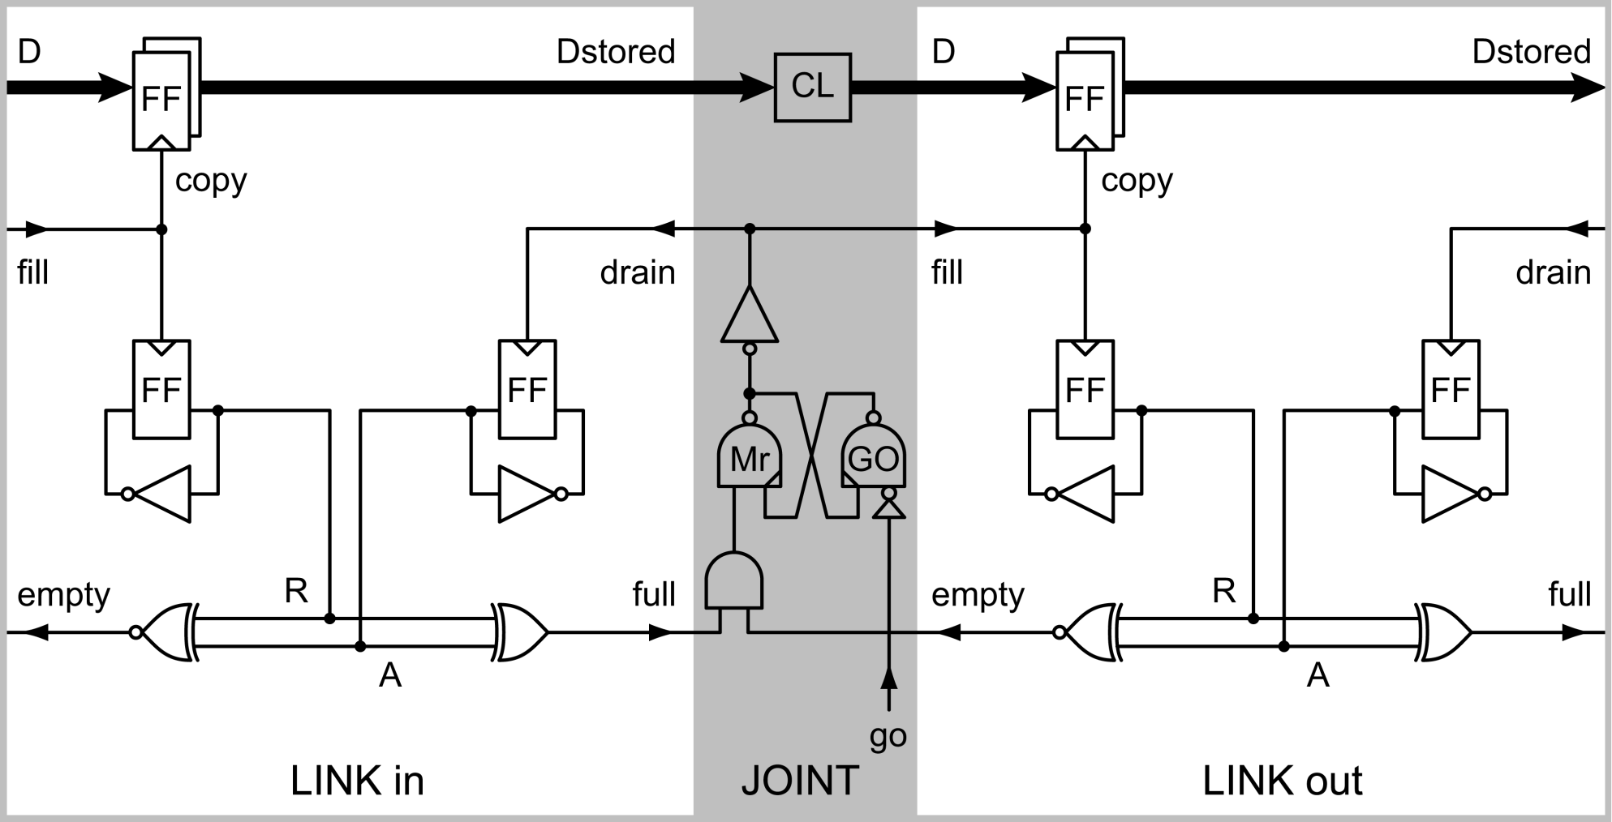
Today: Dual Citizen Circuits Click FIFO with self-timed action

Slide 6
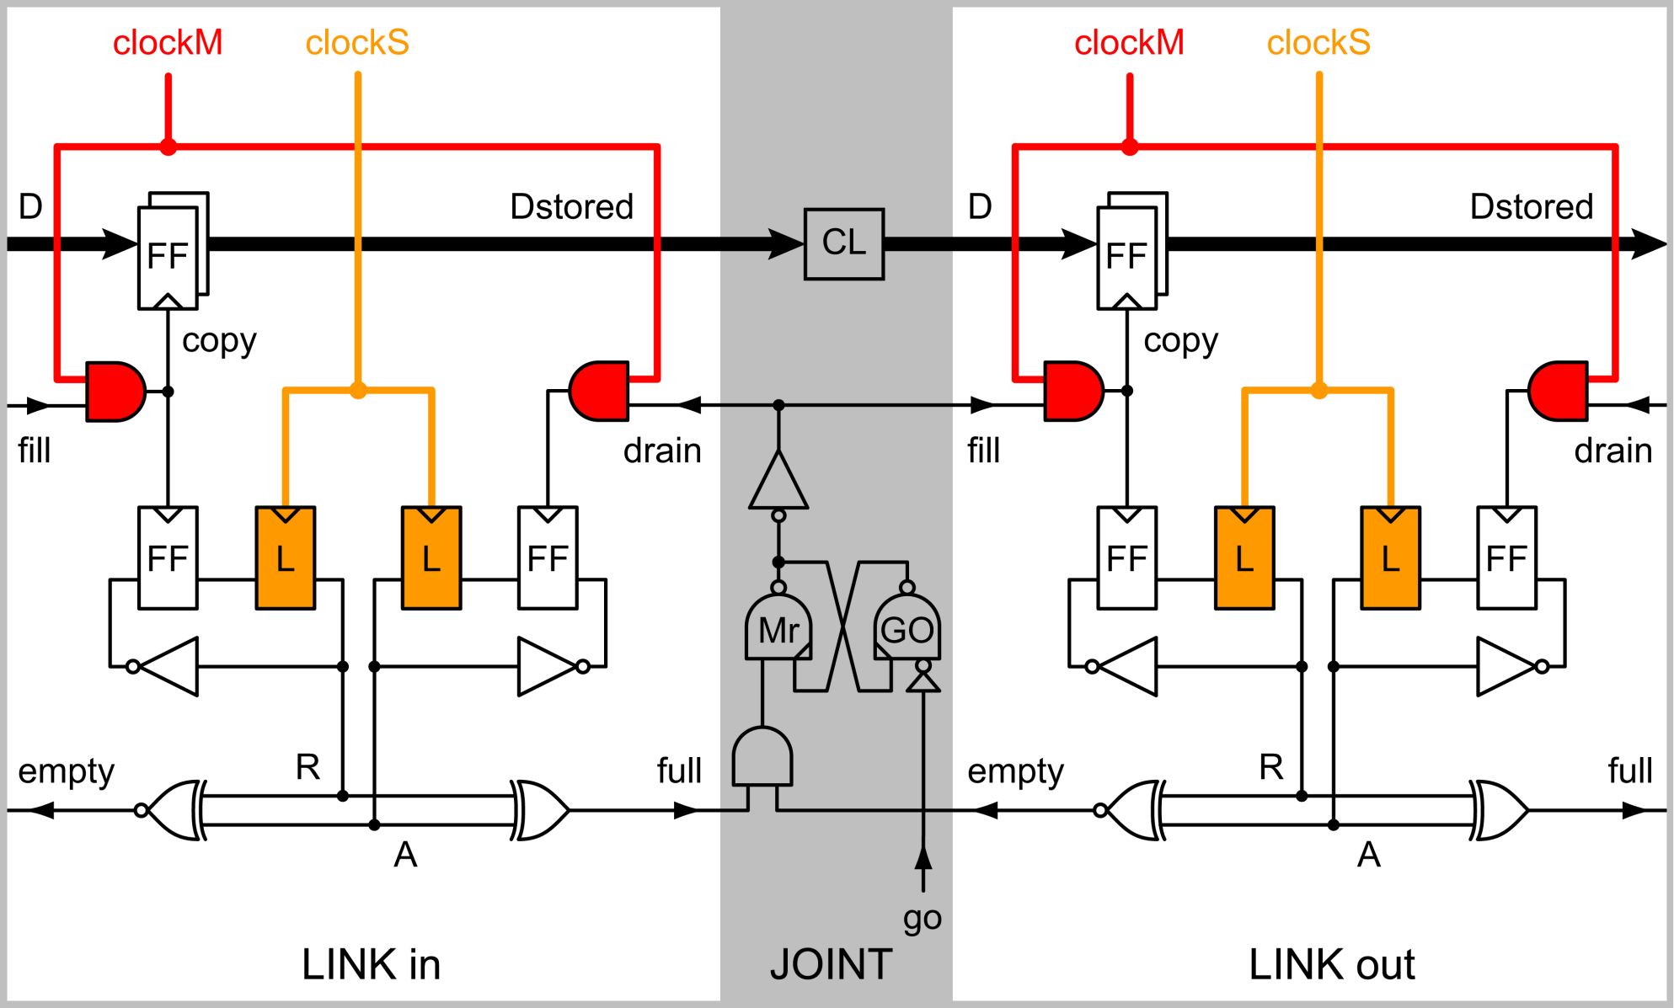
Today: Dual Citizen Circuits Click FIFO with self-timed action or clocked action

Slide 7
Motivation
Risk reduction
The clocked operations re-use the self-timed fabric and can therefore
help build confidence that the self-timed circuits work
retard any aging or erratic self-timed operations that need more time to finish
Elasticity
The clocked operations re-use the self-timed protocols and therefore
inherit the self-timed elasticity to act only when and where needed
Turbo mode
When needed, the self-timed mode can provide a performance boost in
latency
throughput
energy
electro-magnetic compatibility
robustness to delay variations

Slide 8
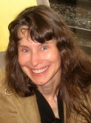
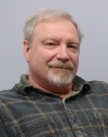
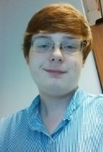
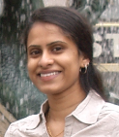
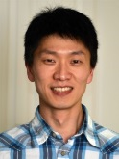
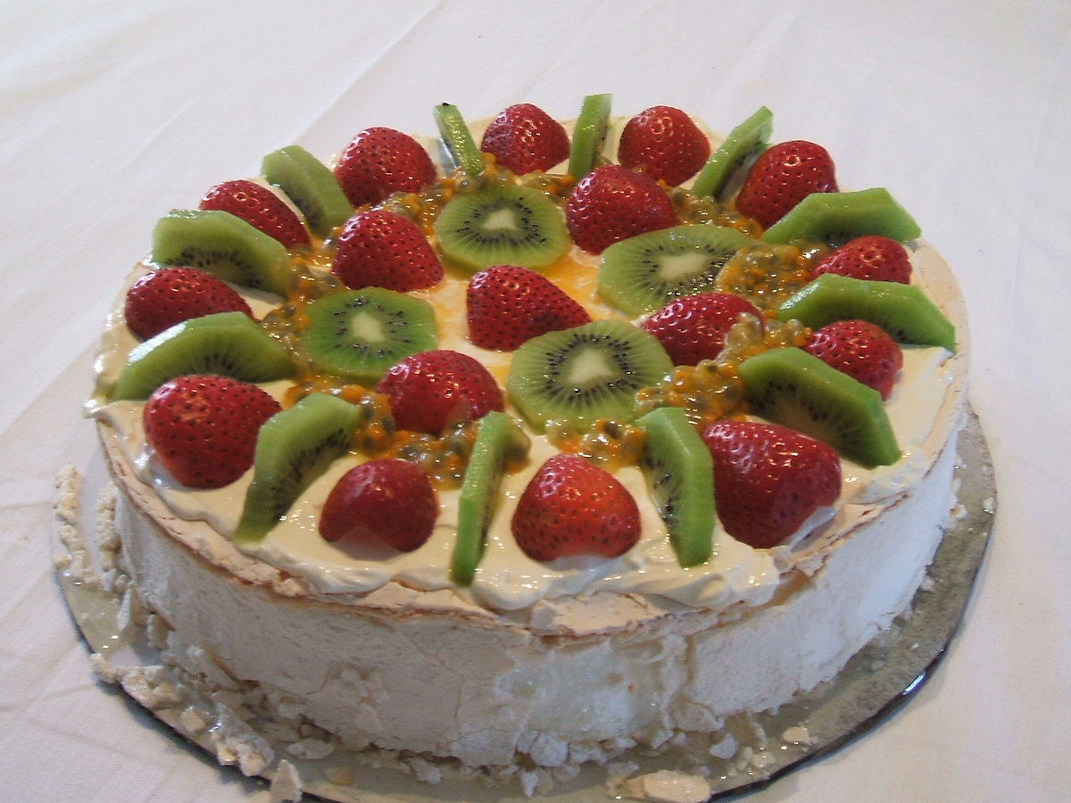
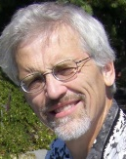
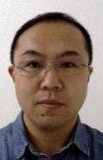
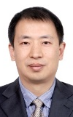
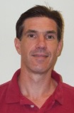
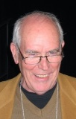
Happy Birthday, Alex!
Pavlova
3 (old) egg whites
9 oz castor sugar
1 tsp vanilla
1 tsp vinegar
1 pinch salt
cream
fruit
Pavlova photo by Hazel Fowler, Wikimedia Commons
Beat egg whites with a pinch of salt
until stiff enough to peak.
Fold in sugar, vanilla, and vinegar.
Place on baking paper on greased tray.
Bake slowly about 1-1.5 hours at 250F.
Dress with fresh whipped cream,
kiwi fruit, strawberries, or similar.
BON APPÉTIT !

Slide 9
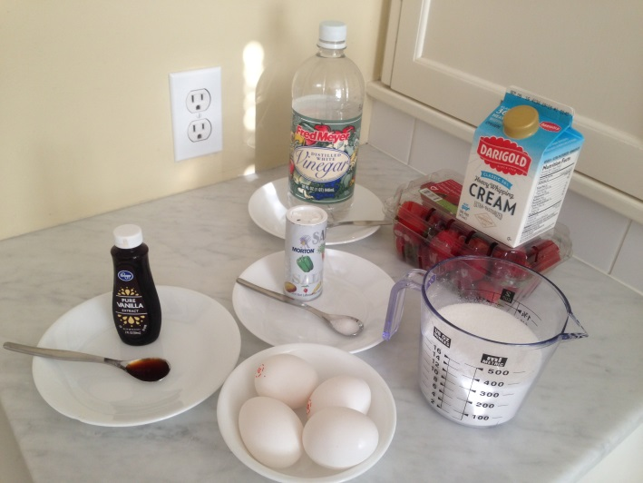
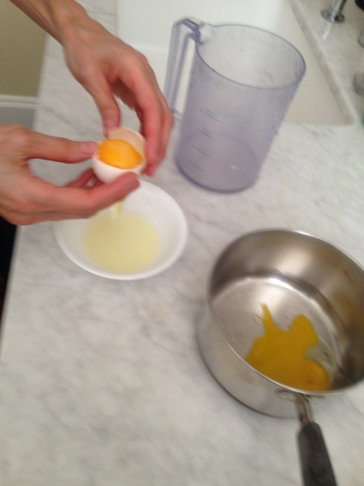
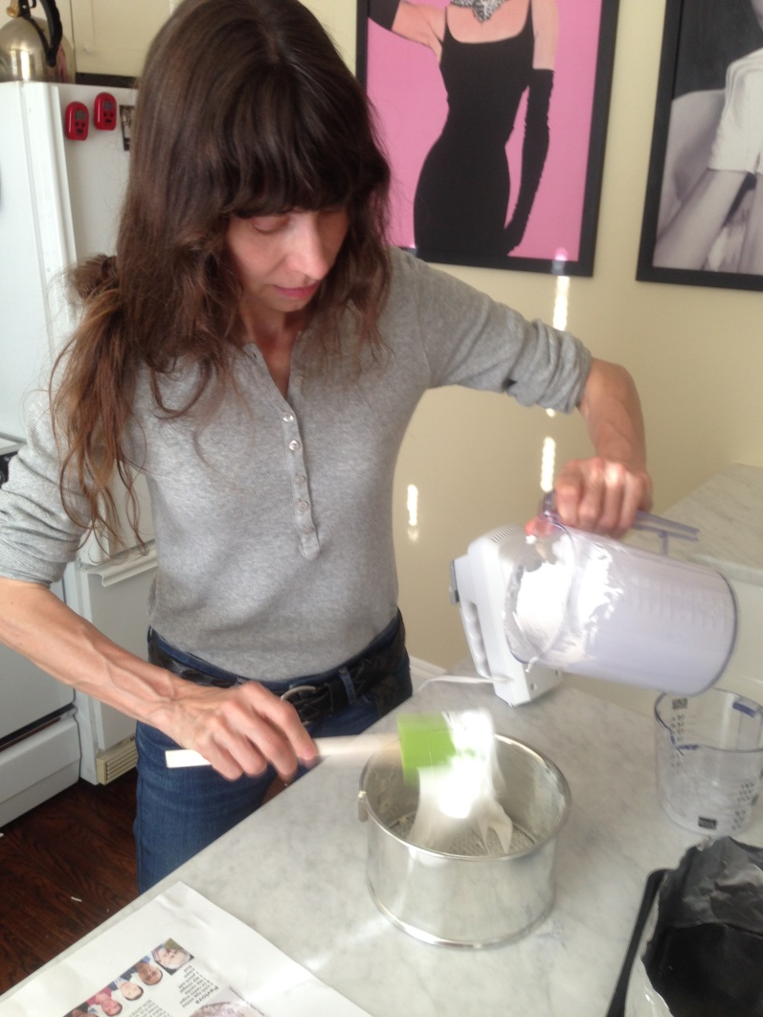
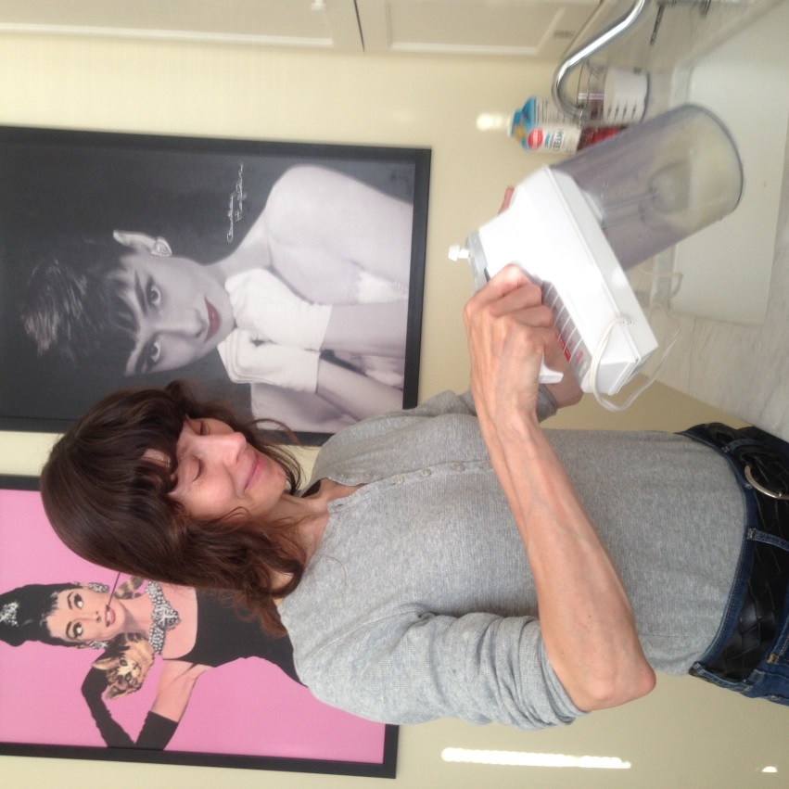
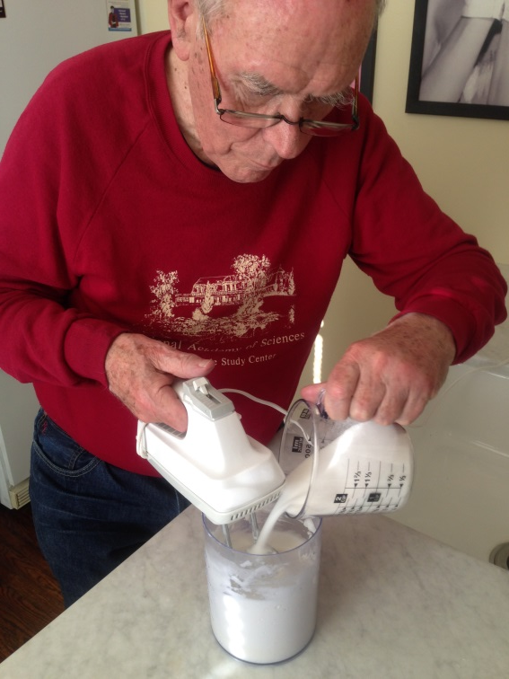
Hooray

Slide 10
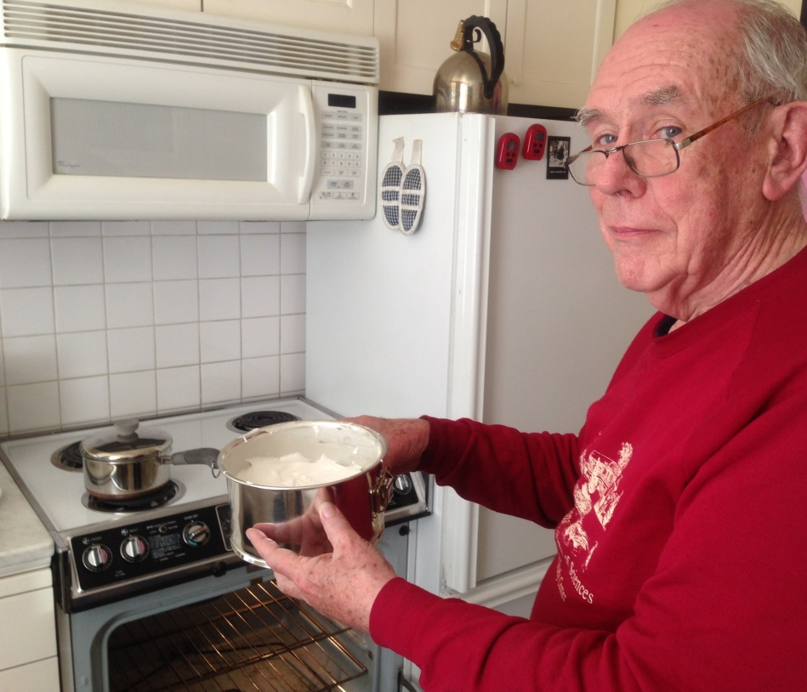
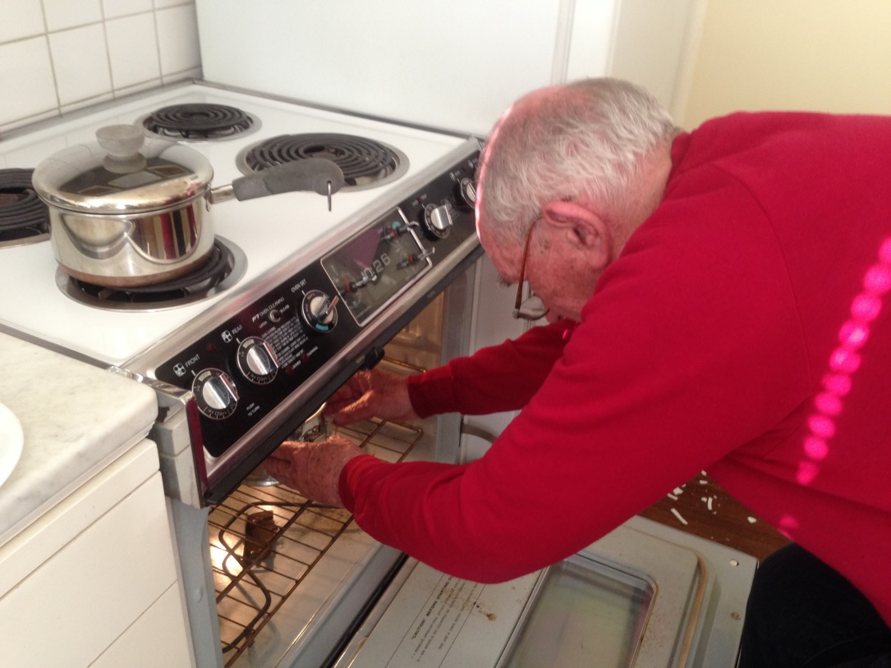
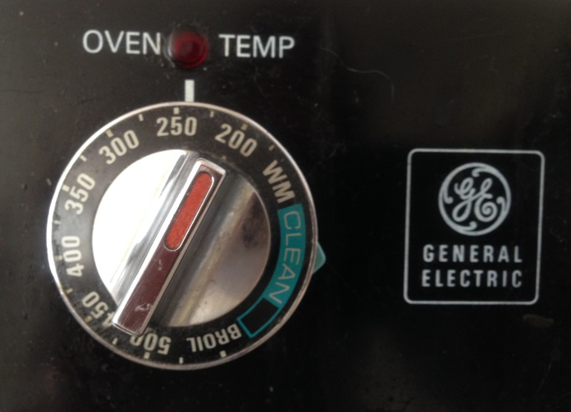
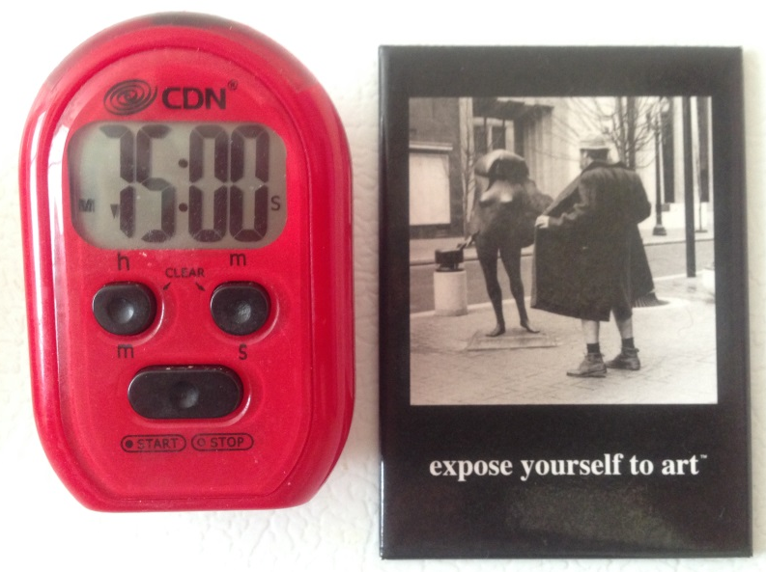
Hooray

Slide 11
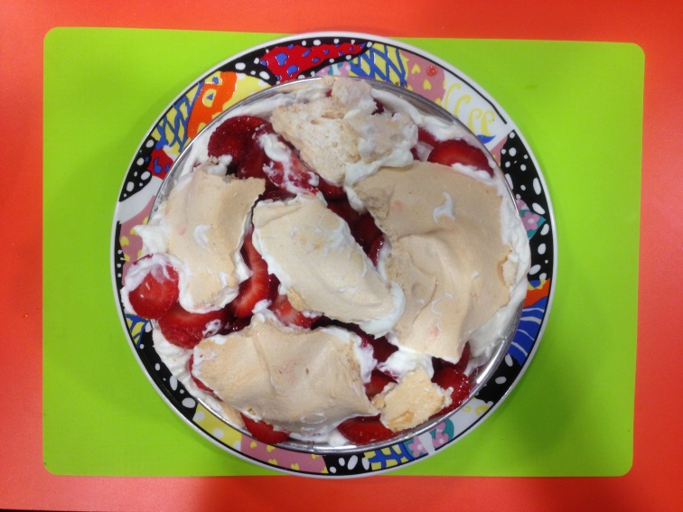
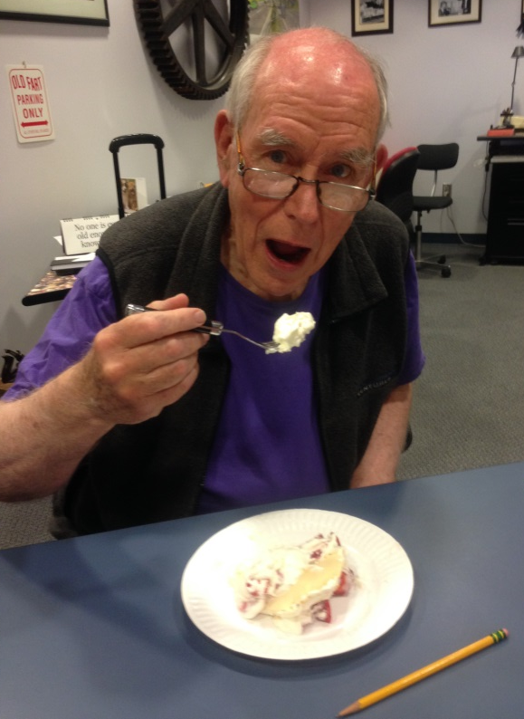
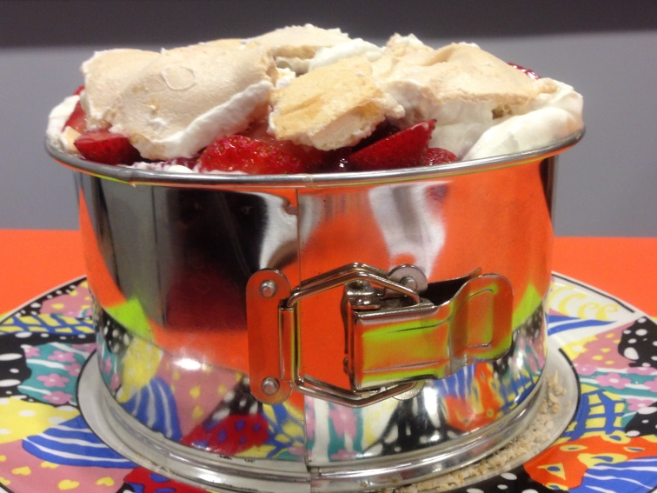
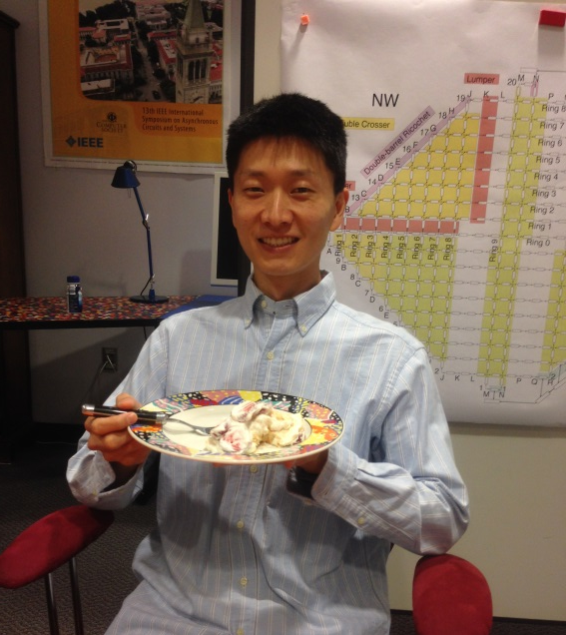
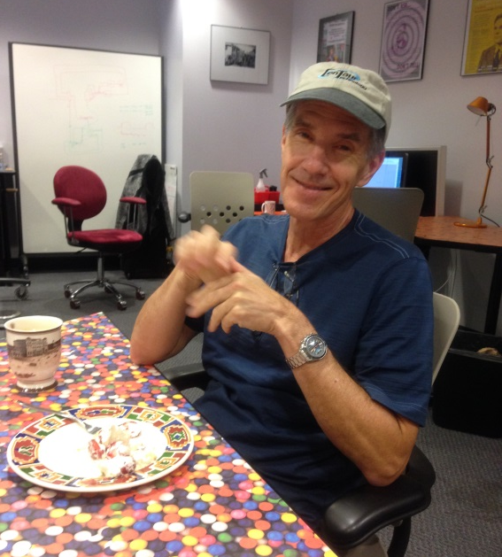
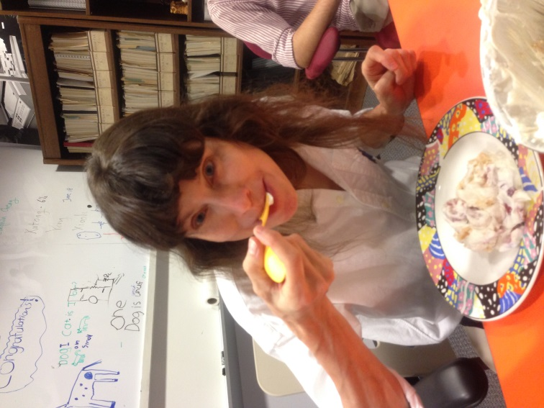
Hooray

Slide 12
This Asynchronous World - Dual Citizen Circuits

